Slide 1
MS SQL Database Installation And Data Import

Slide 2

Introduction
  In this presentation we will:
  Install MSSQL database
  Create our own database inside MSSQL
  Fill the database with data from XLS file

Slide 3
Database Installation
  Install a new database – MSSQL
    Download at:
    http://www.microsoft.com/downloads/details.aspx?familyid=413
    744d1-a0bc-479f-bafa-e4b278eb9147&displaylang=en
    Run a command line and type: setup.exe SAPWD = “Password” SECURITYMODE = SQL
  Install SQL Manager for SQL server
    Download at:
    http://www.sqlmanager.net/en/downloads
    Install the product
Notes:
First Installation: This installs the MSSQL in a mixed mode, connection to it is checked by both NT authentication and own user database authentication
SAPWD specifies the password for the System Administrator, in our case ‘Password’. You can change it to your own password.
This SQL manager allows us to create a table in our database and fill it with variable values

Slide 4
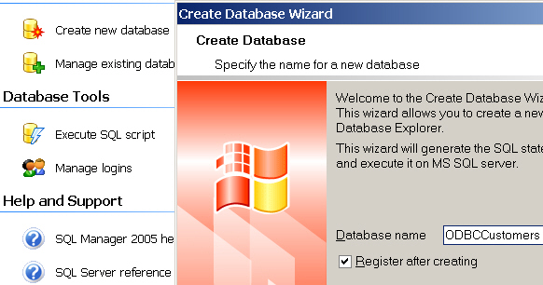
Database Creation – SQL Manager
  Start SQL Manager and click Create new database
  Specify its name and leave Register after creating checked
  Click Next and at the end Finish, then a new database is created
Notes:
The database name will be e.g. ODBCCustomers

Slide 5
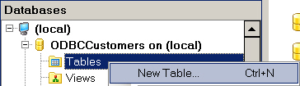
Table Creation
  For working with a database it is necessary to connect to it
  Right click on database name and select Connect to Database
  For inserting new values it is necessary to create a table
  Right click on Tables and select New Table
Notes:
Connecting to a database opens a database for working inside

Slide 6
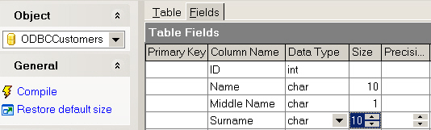
Table Definition
  Select Fields tab
  Specify Column Name, Data Type and Size (for characters)
  Click Compile and then Commit to modify a table
Notes:
In this section users define what the table will contain (column name and variable type in it)

Slide 7
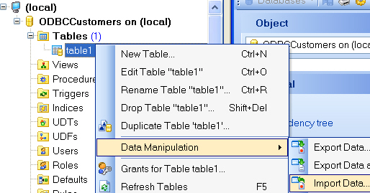
Data Importing
  After table creation we need to import data into it
  Right click on table name in the tree
  Select Data Manipulation | Import Data
Notes:
It is possible to specify data manually or by Import Data command

Slide 8
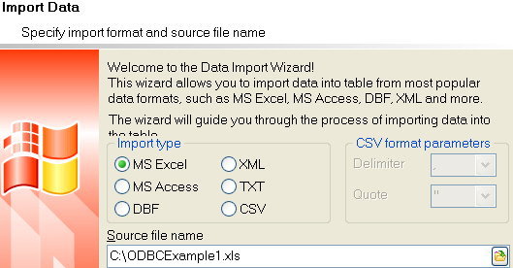
Data Importing
  Select the data type, in this case MS Excel
  Specify Source file name
Notes:
It is possible to select many data types

Slide 9
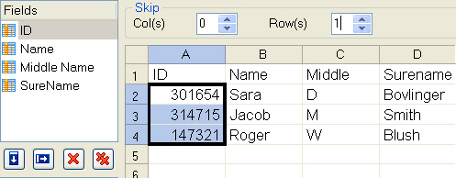
Data Importing
  Now it is important to specify whether the direction of variables
  is vertical or horizontal
  Set Auto fill columns option
  Specify number of rows to skip
Notes:
If the direction is vertical (this case) then the fields we specified will be columns, if the direction is horizontal then the fields we specified will be rows
Highlight first column, and set auto fill cols, then select rows to skip, and it will skip the header
The reason why to skip rows is because there is a header in the XLS file (containing ID, Name, Middle and Surname) and a header in the table in SQL Manager (which we specified before) as well, so there is no need to display two headers.
SQL Manager shows you the variable values taken into account interactively by framing them by a black line

Slide 10
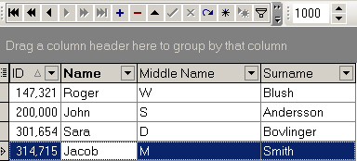
Data Importing
  After clicking Next and then Finish button, the table is filled
  with values from the XLS file
  It is possible to display Error Log as well
  Records can be added to or deleted from the table manually
Notes:
Manual addition: by pressing Insert record button user will add a new record which is filled in manually
The table is created and filled. Close the SQL Manager.

Slide 11

Thank You.
Do You Have Any Questions?

